Slide 1

Project Quack
Presented by
The Bestagons
Notes:
Mimi

Slide 2

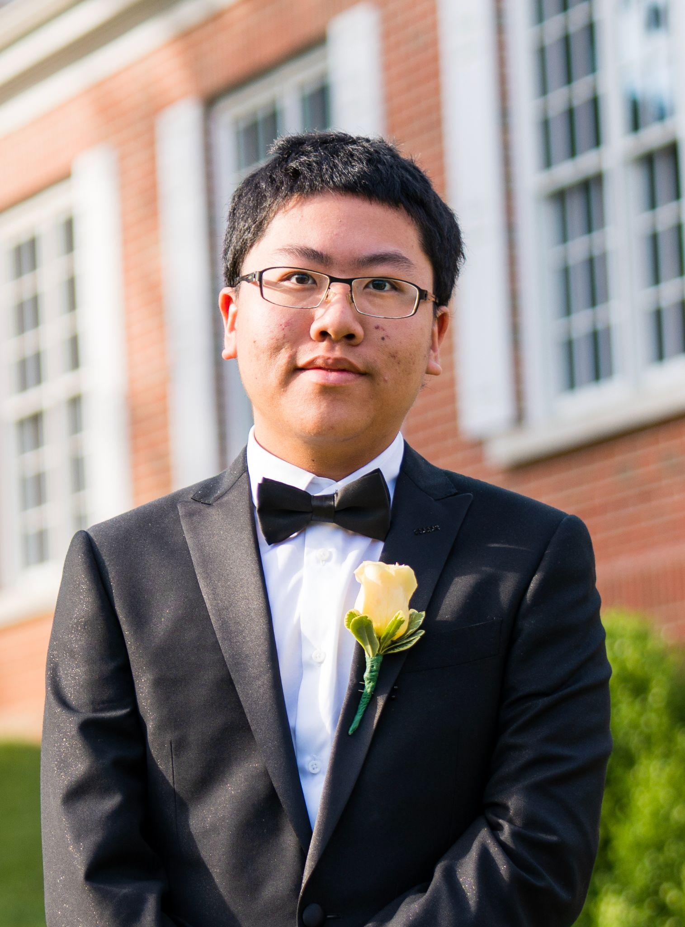

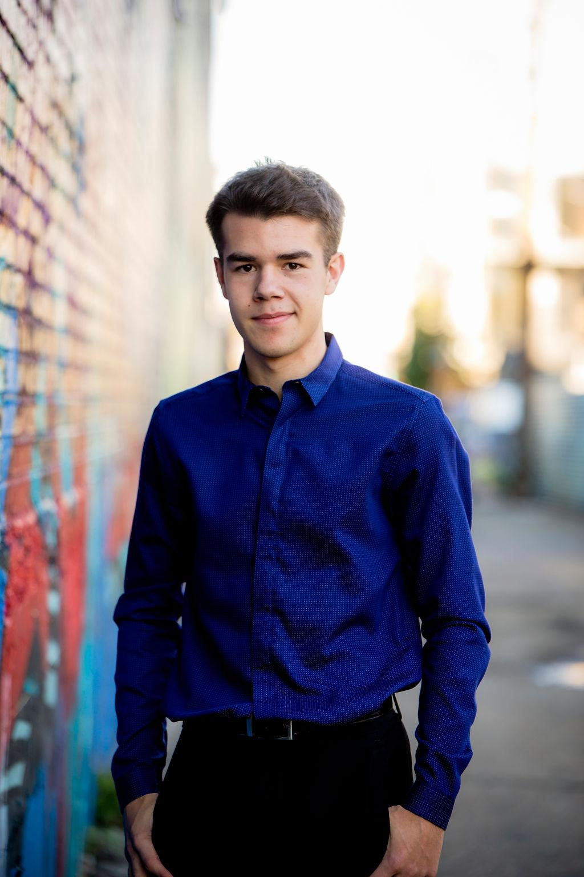
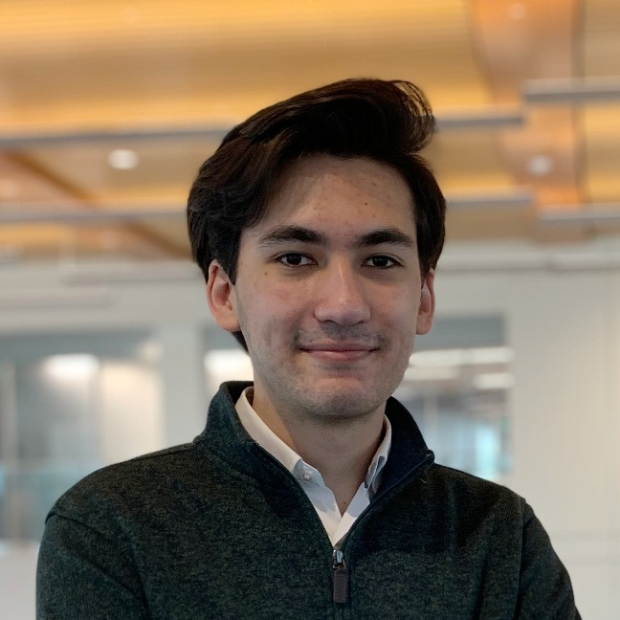
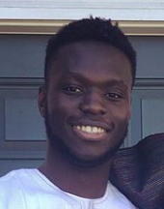
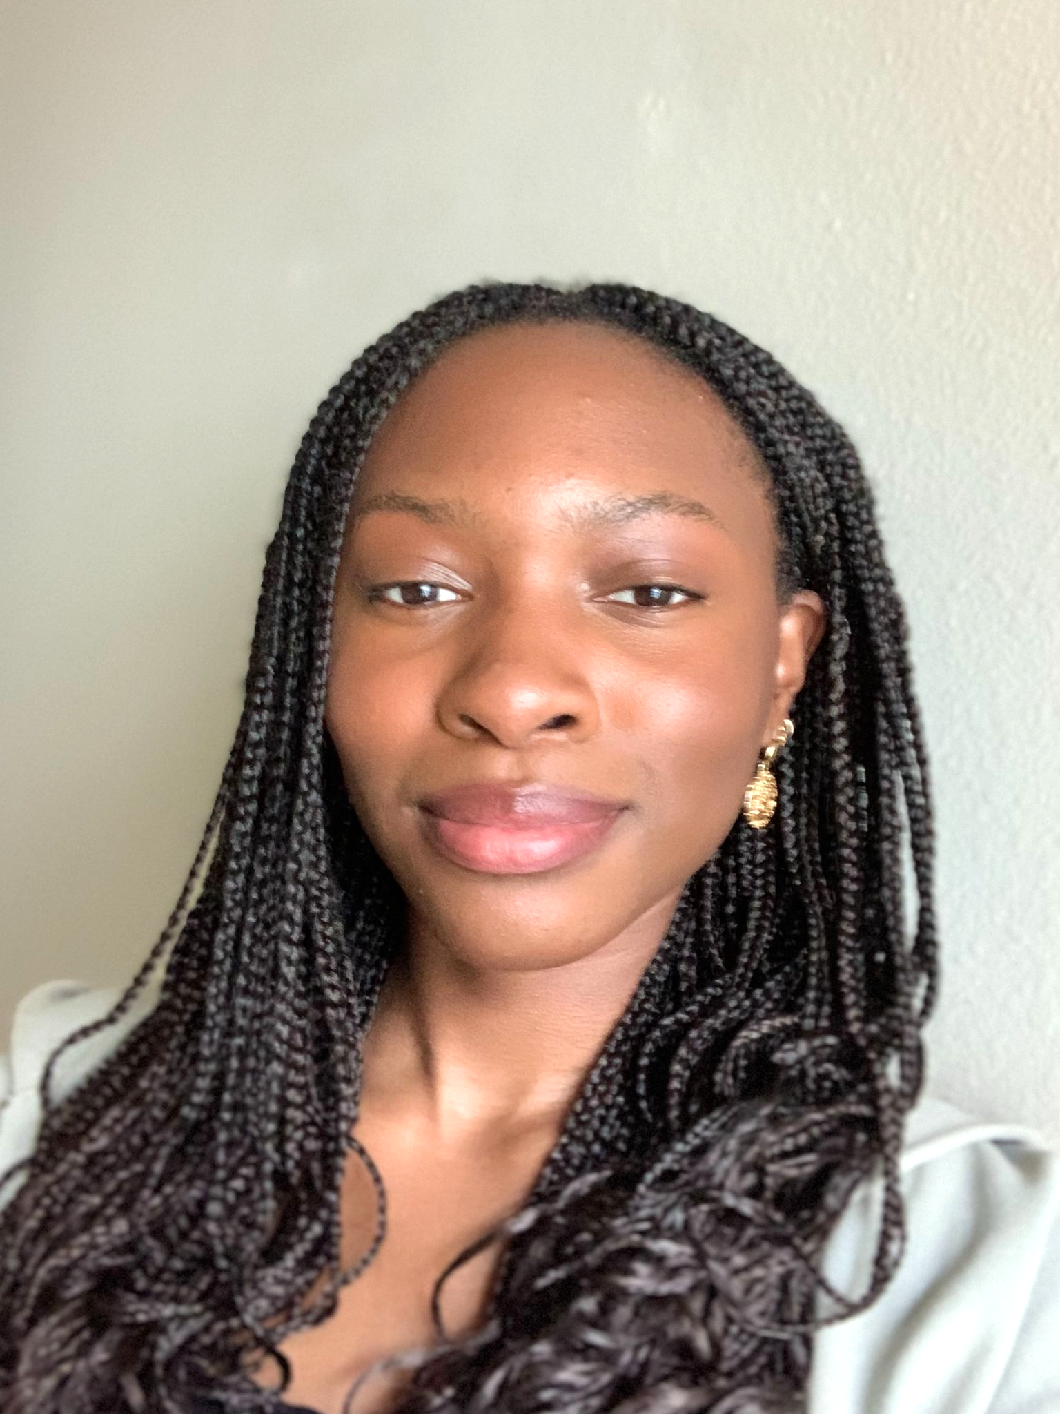
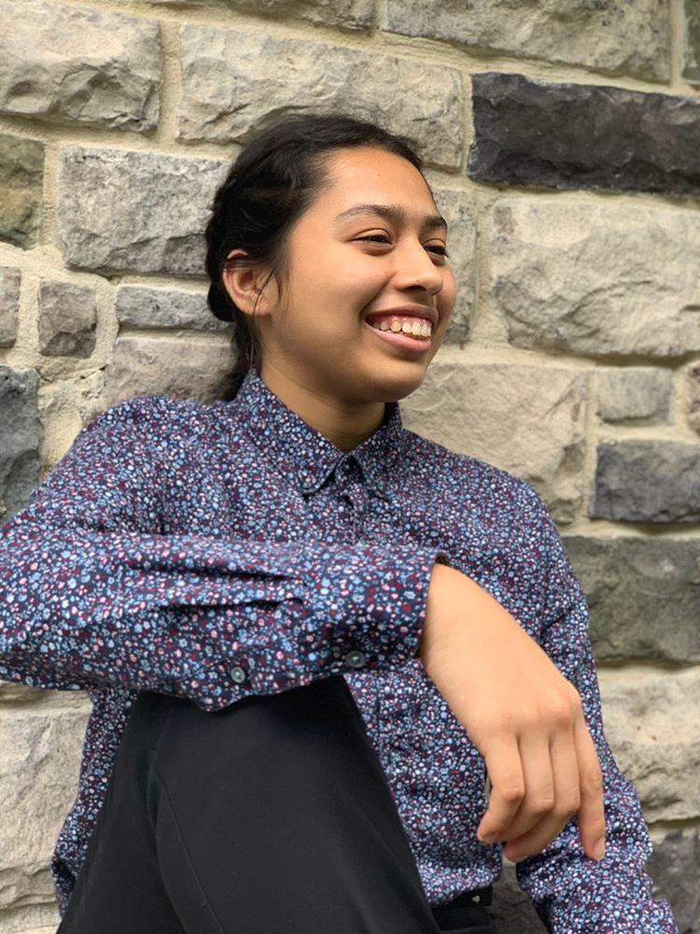
OUR TEAM
Miles Robertson
Rafael Piloto
Ore Adenikinju
Mimi Olayeye
Brenda Cano
David Wei
Product Owner
Scrum Master
Team member
Team Member
Team Member
Team member
Notes:
Mimi

Slide 3
AGENDA
01
03
02
Acknowledging Feedback
What are our goals for the week?
What did we accomplish?
Notes:
Mimi

Slide 4
01
Acknowledging Feedback
Notes:
Brenda

Slide 5
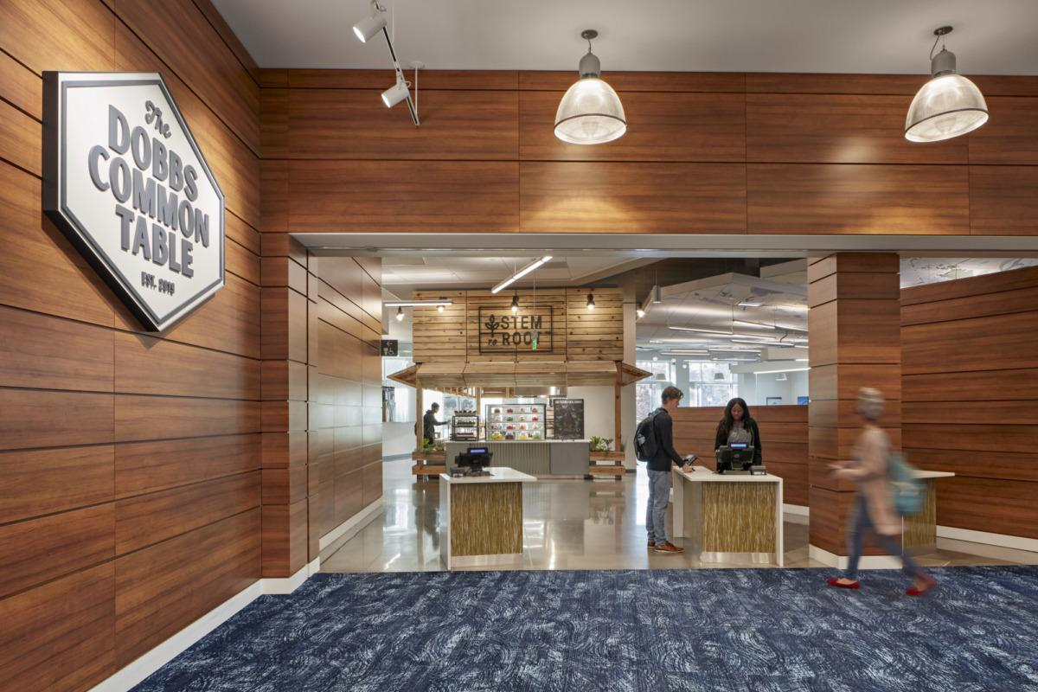
Feature Ideas
We were given a lot of great feature ideas but will not be able to implement them and have them working properly for our last sprint
Web Scraper
The web scraper will connect to the helper methods in the backend and store that information which will be sent to be displayed in the frontend
Notes:
Brenda

Slide 6
02
What did we accomplish?
Notes:
Mimi

Slide 7

Reduced Scope for Sprint 9
Due to unexpected illnesses
1/2 of team got sick
Micro - charter → risk of illness
Notes:
Mimi

Slide 8
JWT
Authentication Token
When users login, they will receive an authentication token
This token will be used to secure specific routes and to get/update user specific information.
Notes:
Brenda

Slide 9
Push Notifications
Ask users for permission to push notifications
Binds the device to the user’s account
Get real time update about food (in implementation)
(Code Demo)
Notes:
David

Slide 10
UI Frontend Updates
Took feedback about app appearance into consideration
Beautify the app through additional color and shading
Trying out various layouts and we will internally choose the most suitable one
Notes:
Ore

Slide 11
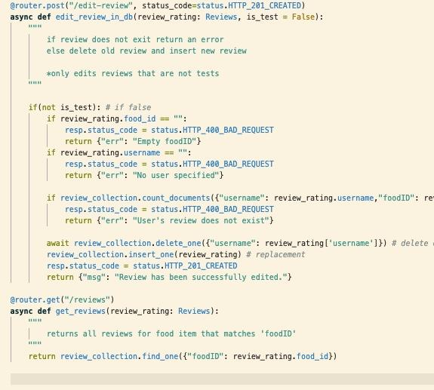
Review feature implementation
Finished Review feature
Added a get method
Refactored code
Using pydantic base model
API router
Notes:
Mimi

Slide 12
03
What are our goals for the week?
Notes:
Miles

Slide 13
Break +9 points
Ahead of schedule!
Notes:
Miles
We have worked ahead enough that we can take a well earned Thanksgiving Break*

Slide 14
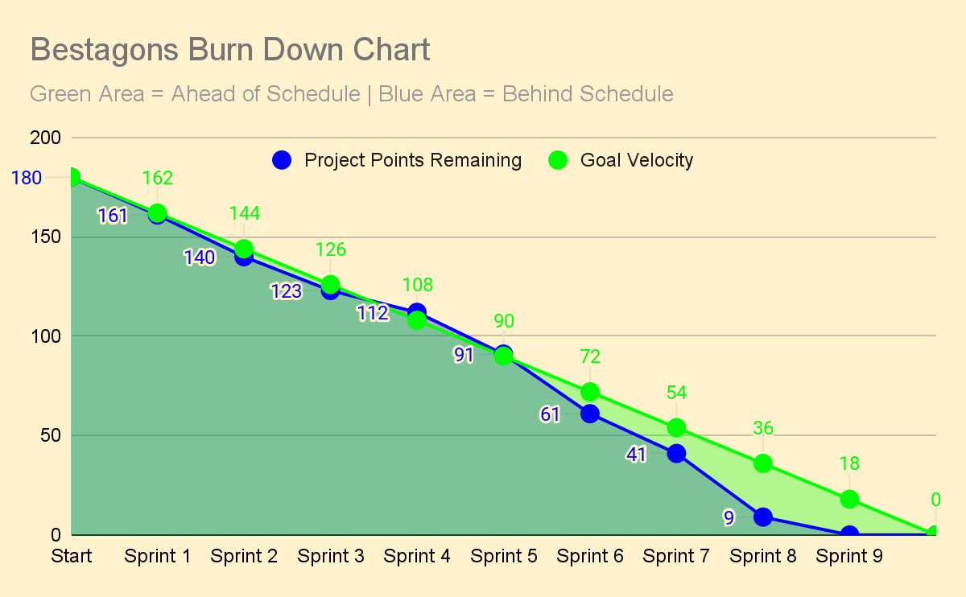
Notes:
Miles
Overshadowing

Slide 15
Remaining
Product Backlog
GitHub Demo!
Revise mini-charter
Get Quack app on each of our phones
Finishing touches!
Notes:
Rafael (Scrum Master) & Miles

Slide 16
THANKS
Please remember to share your feedback :)
Notes:
Miles

